Slide 1

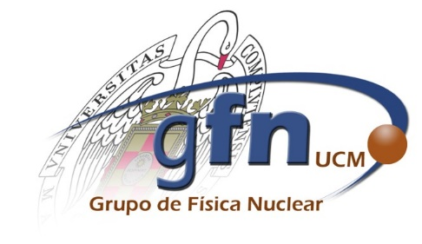

A State-of-the-Art Deep Learning Approach to Proton Dose Reconstruction from PET Activity Measurements
Pablo Cabrales¹, Víctor V. Onecha^{1,2}, Pablo Galve^{1,2}, Paula Ibáñez^{1,2}, Clara Freijo^{1,2}, Fernando Arias Valcayo^{1,2}, Daniel Sánchez Parcerisa^{1,2}, Samuel España^{1,2,3}, Luis Mario Fraile^{1,2},
José Manuel Udías^{1,2}, and Joaquín L. Herraiz^{1,2}
¹Grupo de Física Nuclear, EMFTEL & IPARCOS, Universidad Complutense de Madrid, CEI Moncloa, Madrid, Spain
²Instituto de Investigación Del Hospital Clínico San Carlos (IdISSC), Ciudad Universitaria, Madrid, Spain
³Centro Nacional de Investigaciones Cardiovasculares (CNIC), Madrid, Spain

Slide 2

Introduction: What is cancer and how do we treat it?
Cancer is the leading cause of death (1 in 6) worldwide
Treatment techniques:
Surgery
Chemotherapy
Immunotherapy
Radiotherapy (> 50% of patients):
Last few decades, a new technique
grows to precisely target tumors
Proton Therapy
© The New York Times
Notes:
These techniques are most often used in combination

Slide 3
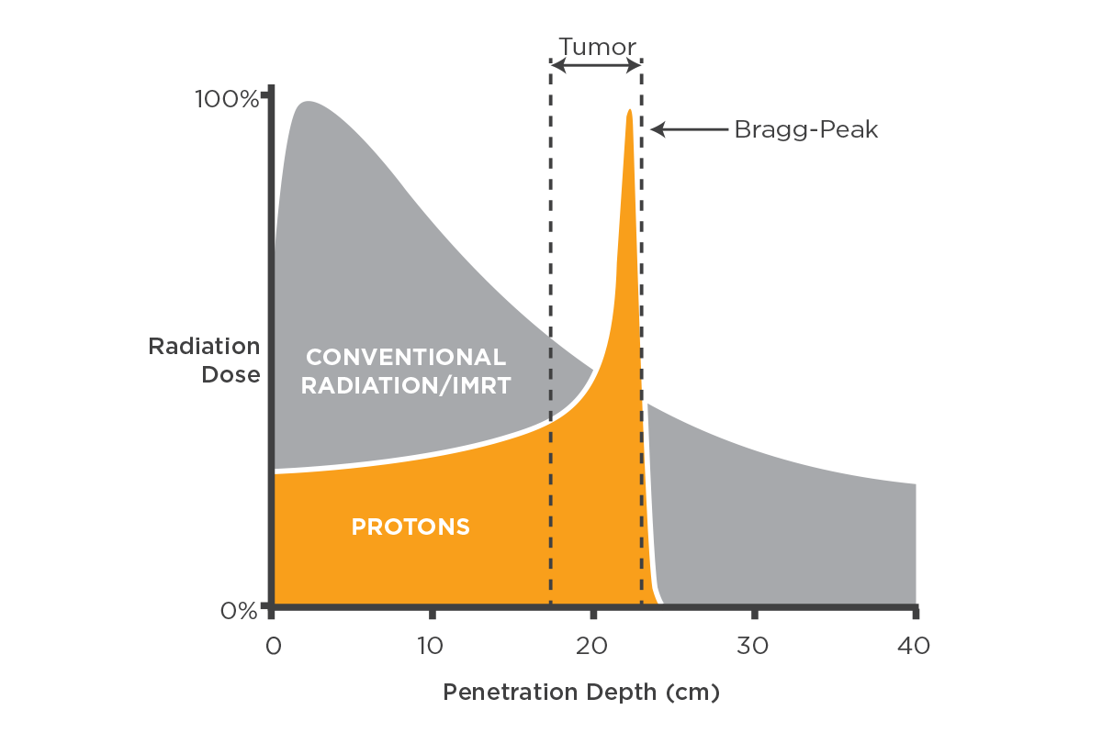
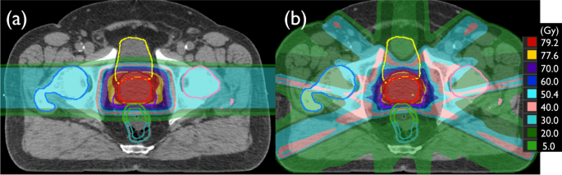
Introduction: What is Proton Therapy?
 | Conventional Radiotherapy | Proton Therapy
Objective | Damage DNA of cancer cells to eliminate the tumor
Radiation Type | High-energy X-rays (photons) | Protons
Dose Deposition | Peak after entering the body | Bragg Peak at specific depth, sharp drop off
Sample Prostate Dose Distribution Kamran et al. 2019
Desouky et al. 2015
Notes:
With proton therapy: we can precisely control depth., radiation spreads beyond the tumor.
Best Suited For: Pediatric tumors; near critical organs.

Slide 4
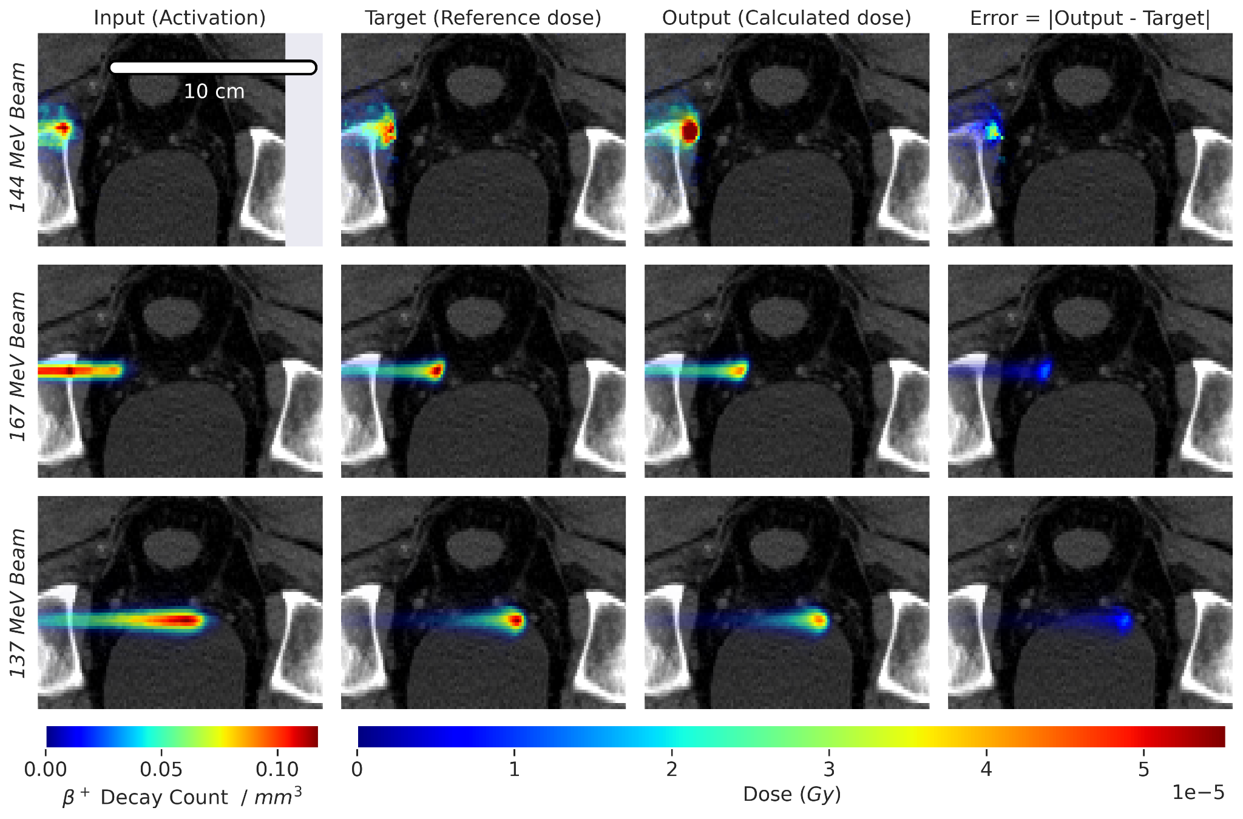
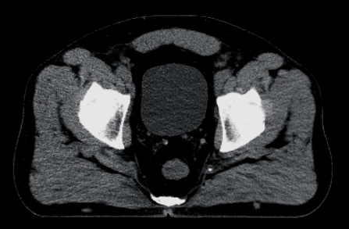
Introduction: Challenges of Proton Therapy
Dose deviations -positioning, physiological changes-
Damage to healthy organs / Tumour undertreatment
Radiation Dose
Need to verify dose deposition
Proton Beam
Proton beams induce e⁺ activity PET
If the relationship between activity and dose is understood, dose deviations can be detected, enabling adjustments between sessions
e⁺ Activity (PET)
Notes:
Dose deviations from the treatment plan
conversion of HU to stopping power
short term physiological changes like organ motion or gas regions
there is no direct way to verify
Induce β+ decay nuclear reactions, which can be imaged using PET
PET widely available system
understanding the relationship is not an easy task, as different physical processes involved in the generation of positron emitting isotopes isotopes compared to the dose deposition.

Slide 5
How?
Current approaches:
Linear Combinations of Beams¹ (fast, limited)
Deep Learning (RNNs^{2,3} -1D, unscalable-, or GANs^{4,5,6} -outdated-)
Introduction: Predicting Dose from Activity
Monte Carlo simulations
Activity-Dose Image Pairs
Models to predict dose (output) from PET measured activity (input)
Model
Activity (Input)
Dose (Output)
¹ Onecha et al. 2021
² Li et al. 2019
³ Liu et al. 2019
⁴ Rahman et al. 2022
⁵ Ma et al. 2020
⁶ Zhang et al. 2021
We propose: State-of-the-Art Vision Transformer Models
trained with goal-oriented metrics
Notes:
perform monte carlo simulations of the proton beams used in the treatment
Linear Combinations of Beams can’t accurately generate beams outside of the simulated beams

Slide 6
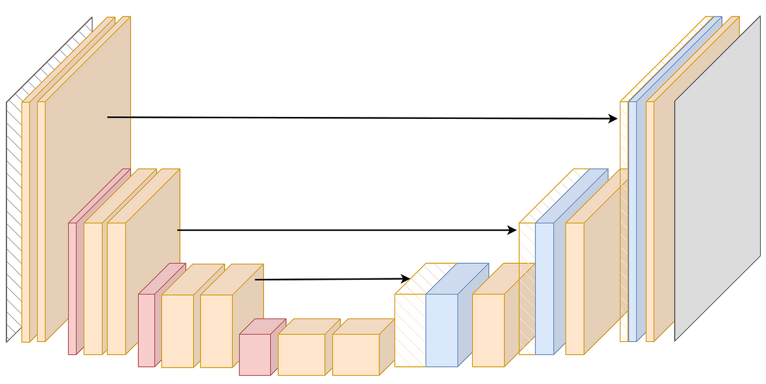
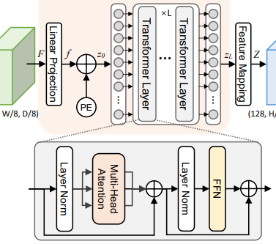
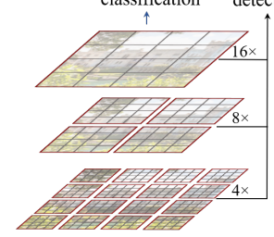
Method: The Neural Networks
Transformers leverage attention to understand the relation between parts of the image
Input: Activity or CT + Activity
Vanilla U-Net
TransBTS
SwinUNETR
Reference; Three layers
Transformer in bottleneck
Transformer applied on Sliding windows at different resolutions
Activity Dose
Wang et al 2021
Hatamizadeh et al 2022
Notes:
incorporate CT to aid the network in learning the stopping power of different tissues
These models were adapted from segmentation models, because our task is similar
U-Net is most simple model, used for reference, downsampling 3d convolutions in the encoder, ant then concatenates the encoder features with upsampled feature maps to produce a final dose image
Due to the limited kernel size of convolution layers in FCNNs, their performance of modeling long-range information is sub-optimal
SwinUNETR first transformer-based model to place competitively in BraTS challenges, adapted from MONAI.
on different resolutions or different layers

Slide 7
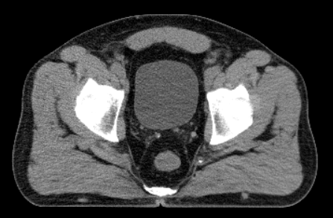
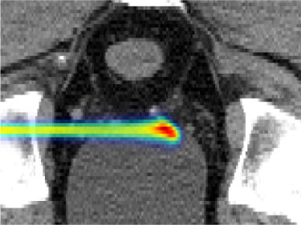
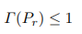
Method: Dictionary Generation and Metrics
Simulation of prostate treatment plan:
Dictionary generation time ~2 hours (TOPAS)
on CT obtained ~24h prior to treatment
10⁵ histories/beam (124 -194 MeV)
Dictionary size ~5 GB (1x2x2 mm resolution)
Metrics:
Training and Testing:
Mean Squared Error
Differentiable Gamma Index
(DTA = 1 mm, Δ = 3%)¹
Only Testing:
Mean Relative Error
Gamma Index
Bragg Peak Deviation
Passing criteria:
DTA (Distance-To-Agreement) = 1mm
Δ = Relative Dose Difference Tolerance = 3%
¹Martinot et al. 2023
Notes:
perform a theoretical study on a prostate treatment
10^8 protons in an actual beam
1mm along the proton beam direction and 2 in the others
the gamma index, for each reference pixel looks at a neighbourhood of pixels within a distance to agreement and looks for the most similar one, weighting by distance, and by a dose difference tolerance. if the value is below one, the pixel passes the criteria. the gamma index is the ratio of pixels that pass the criteria wrt to the toal
however the passing criteria function is not continuously differentiable, so it is approximated with a sigmoid
argmax does not yield continuously differentiable custom loss functions.

Slide 8
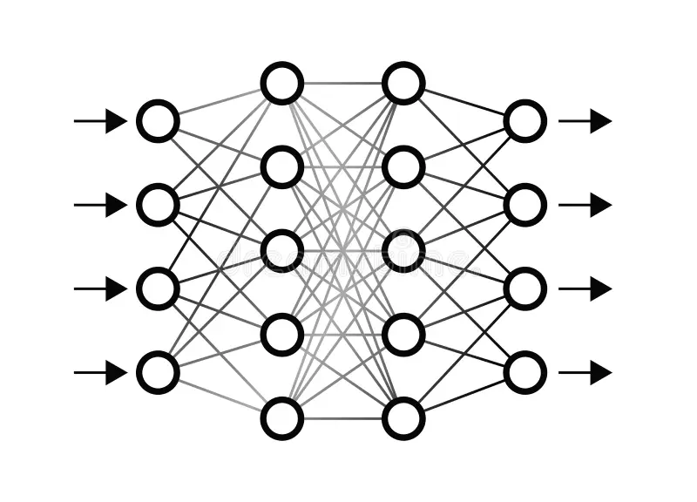
Method: A novel method for out-of-distribution sample detection
Neural Networks may fail with cases outside of their training data distribution
It is important to be able to identify out-of-distribution (OOD) samples
PROPOSED METHOD: Train both the direct & reverse models: Dose (Input) to Activity (Output)
The iterative application of both models will deviate from the original case if sample is OOD
Activity
Dose
Notes:
utilizing that neural networks are best at learning the training distribution, and something clearly out of it, it will not identify it as a normal sample
if its ood, the output activity will be different from the input activity because it will not be able to generate it

Slide 9
Results: Model Performance
(In bold, the best result)
 | Vanilla U-Net | TransBTS | SwinUNETR | SwinUNETR w/ CT | SwinUNETR w/ Gamma Loss
Mean Squared Error [%] | 0.25 | 0.17 | 0.13 | 0.15 | 0.10
Mean Relative Error [%] | 0.024 | 0.026 | 0.021 | 0.027 | 0.021
Bragg Peak Deviation [mm] | 0.65 | 0.60 | 0.56 | 0.59 | 0.55
Diff. Gamma Index (1mm, 3%) [%] | 97.07 | 97.86 | 98.30 | 98.50 | 98.57
Gamma Index (1mm, 3%) [%] | 99.40 | 99.80 | 99.99 | 99.98 | 99.95
Training Time [s] 50 epochs w/ NVidia GeForce RTX 2080Ti | 1h 38min | 2h42min | 2h36min | 3h2min | 2h41min
Output Generation Time [s] | < 0.1 s
Notes:
we tuned the hyperparameters of the SwinUNETR model
in bold, the best option
trained model size is 5mb for unet, 70mb for swinunetr, 128mb for transbts

Slide 10
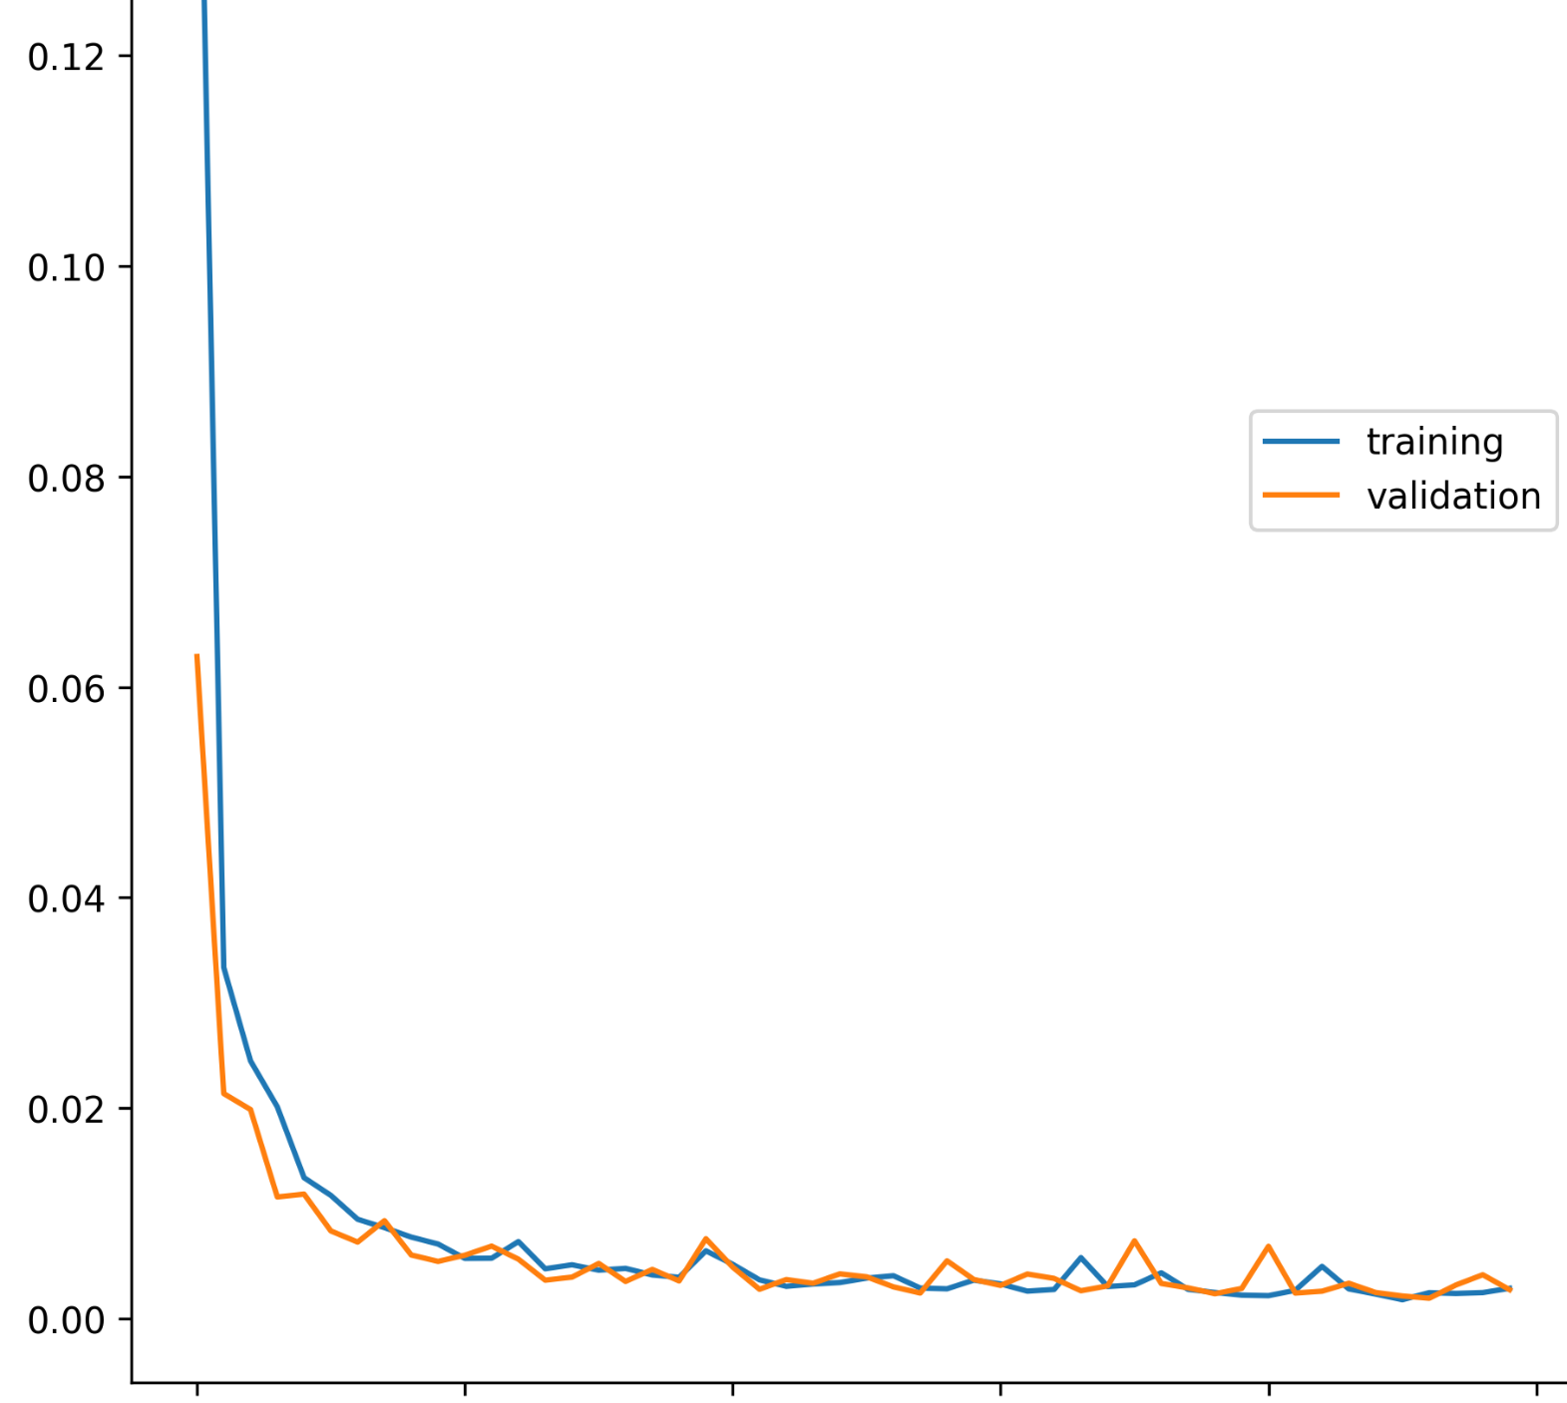
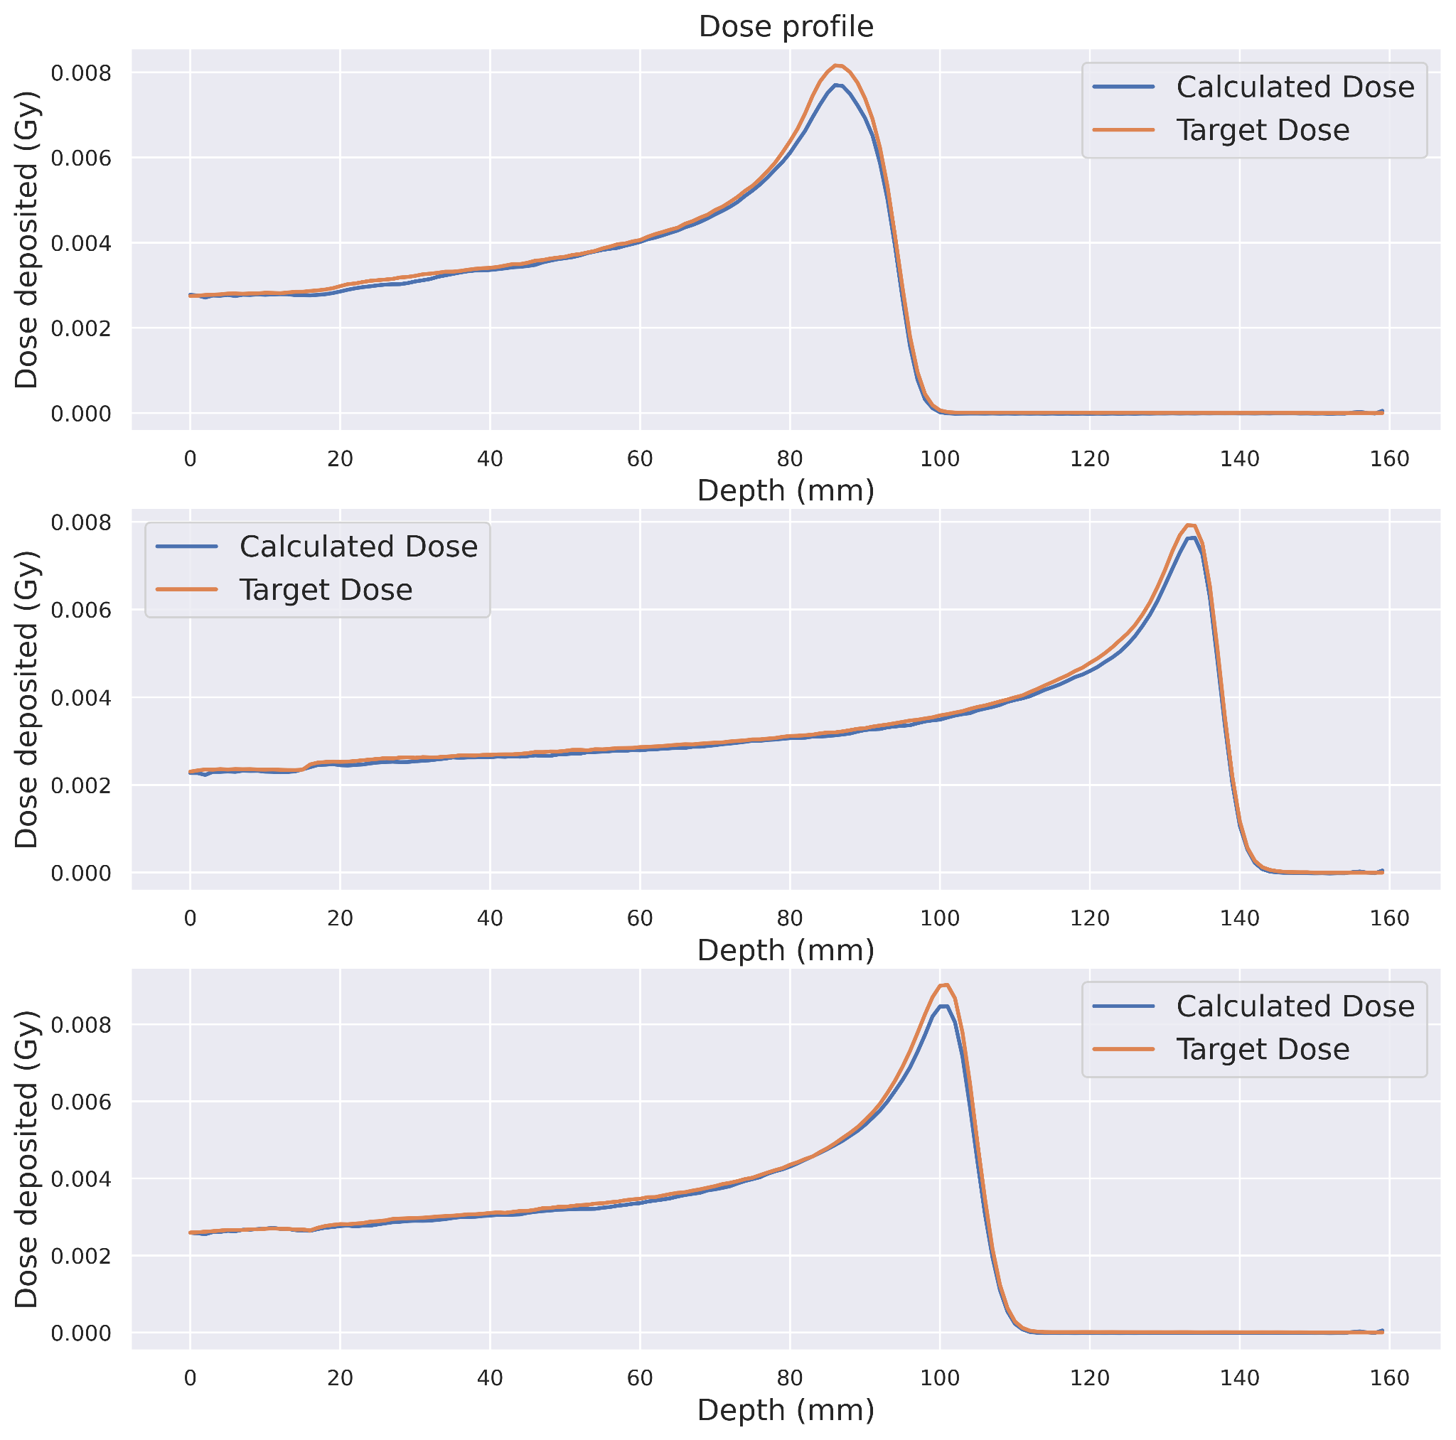
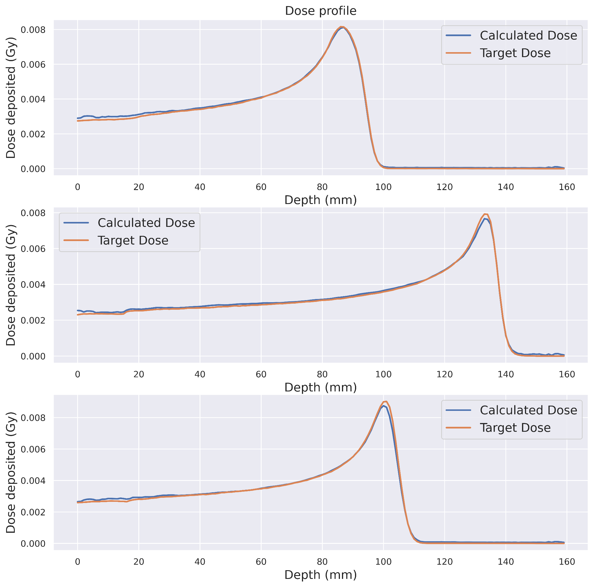
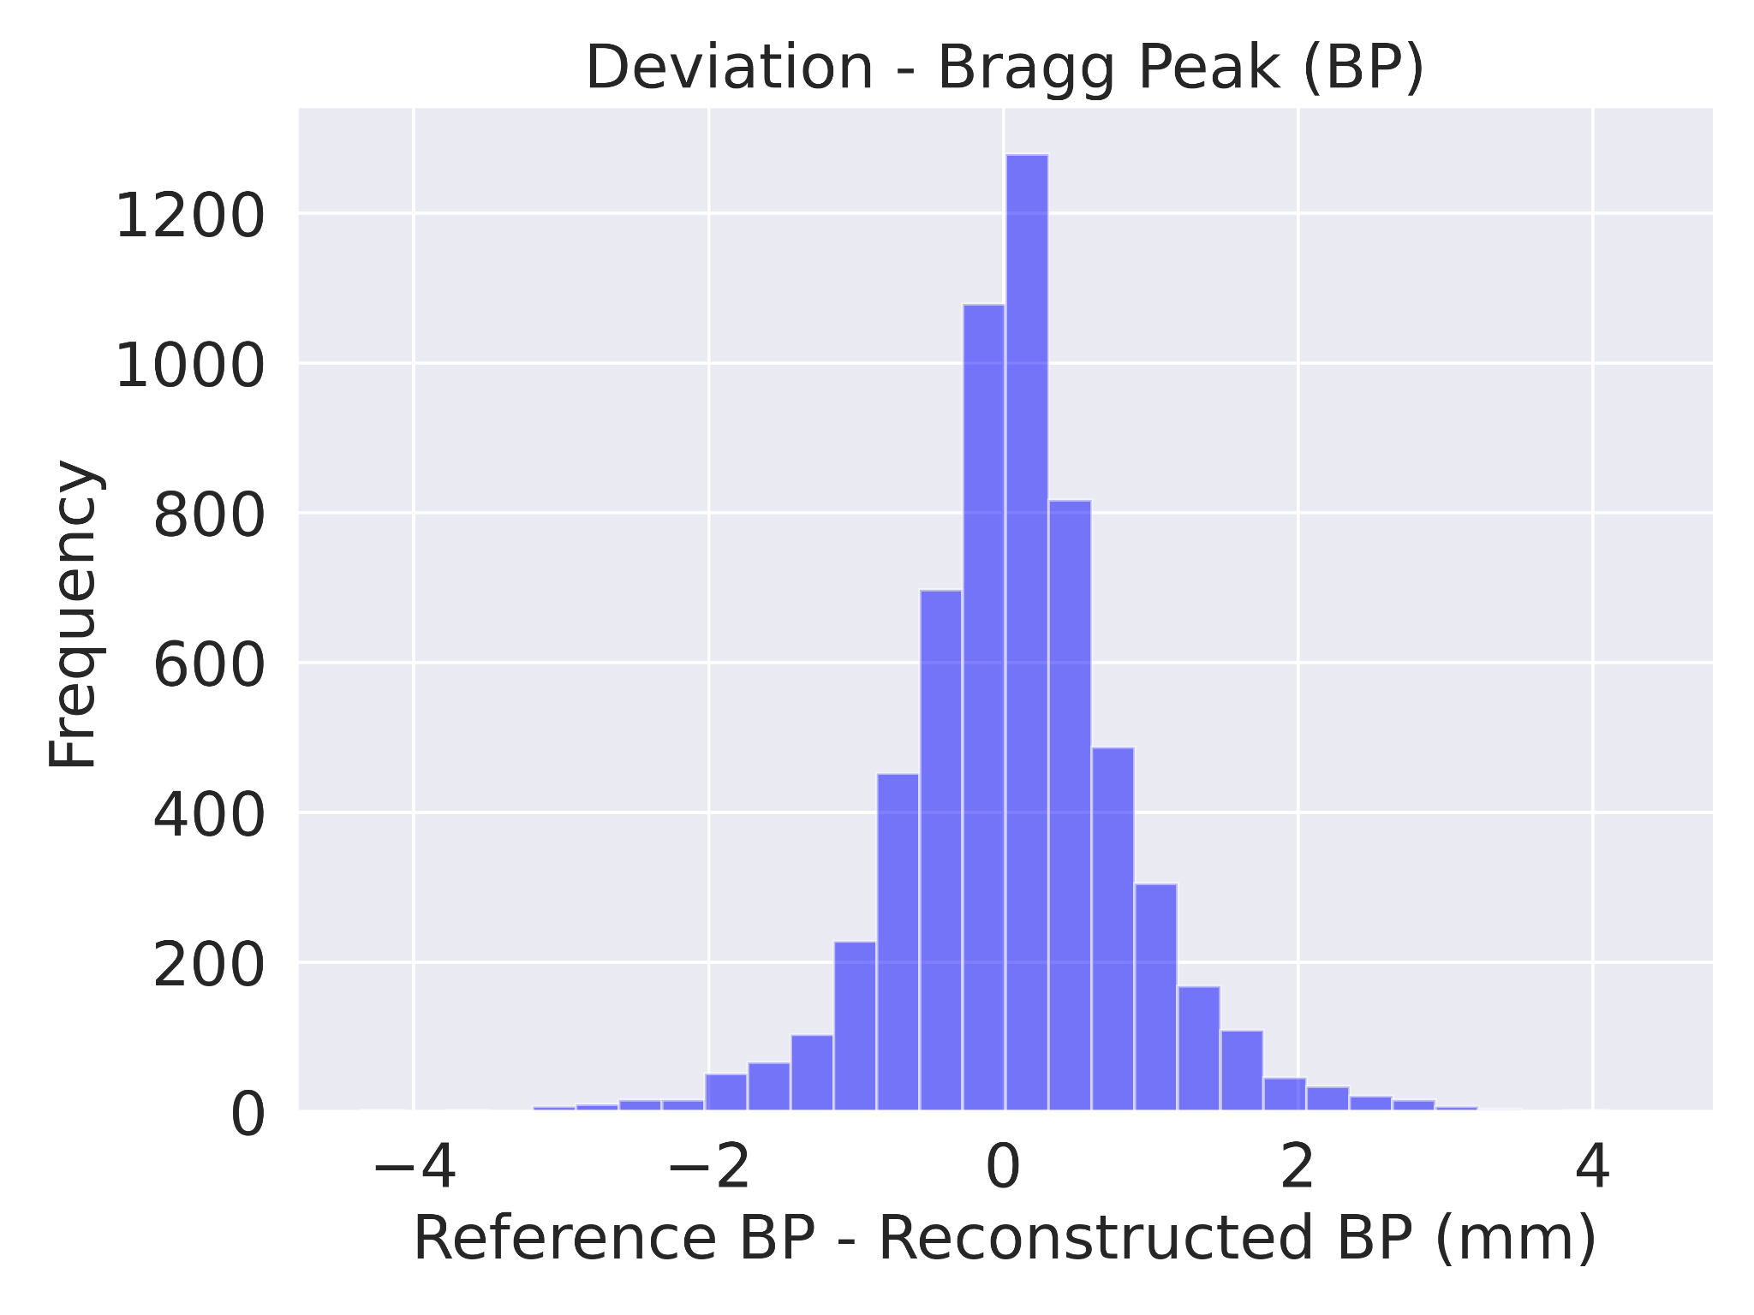
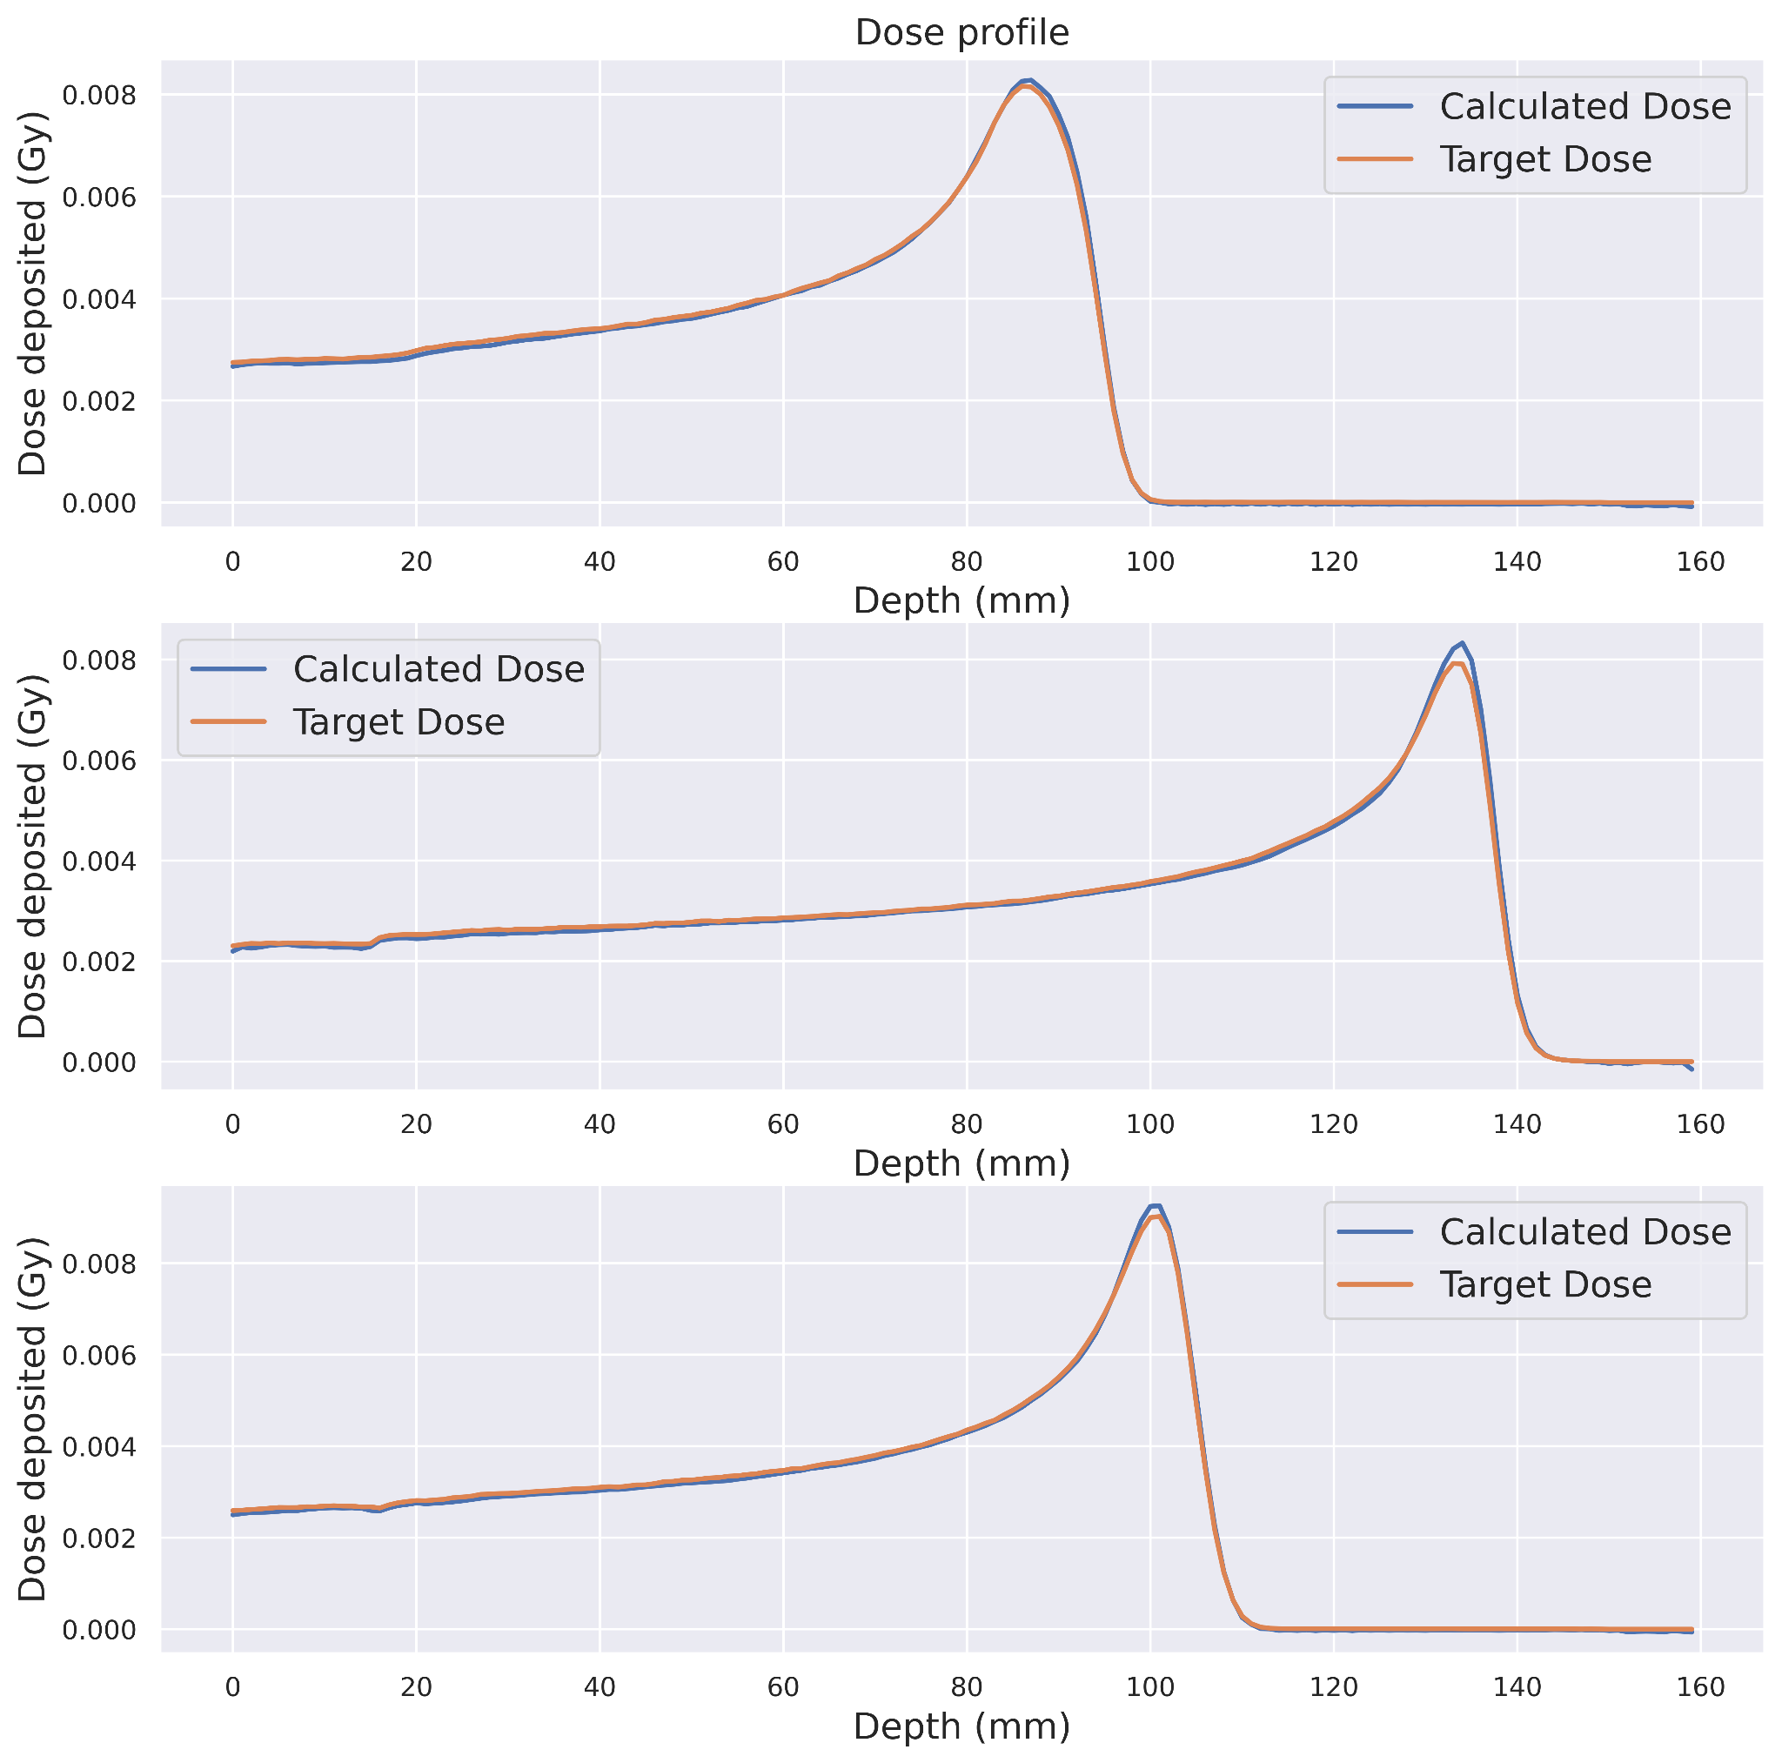
Results: Sample Performance
Loss
Training
Validation
U-Net
TransBTS
0 10 20 30 40 50
Epochs
SwinUNETR
Depth (mm)
Notes:
u-net underestimates
loss convergence plot, could be stopped earlier
we can extract the dose deposition profile for every row along the direction of the beam

Slide 11
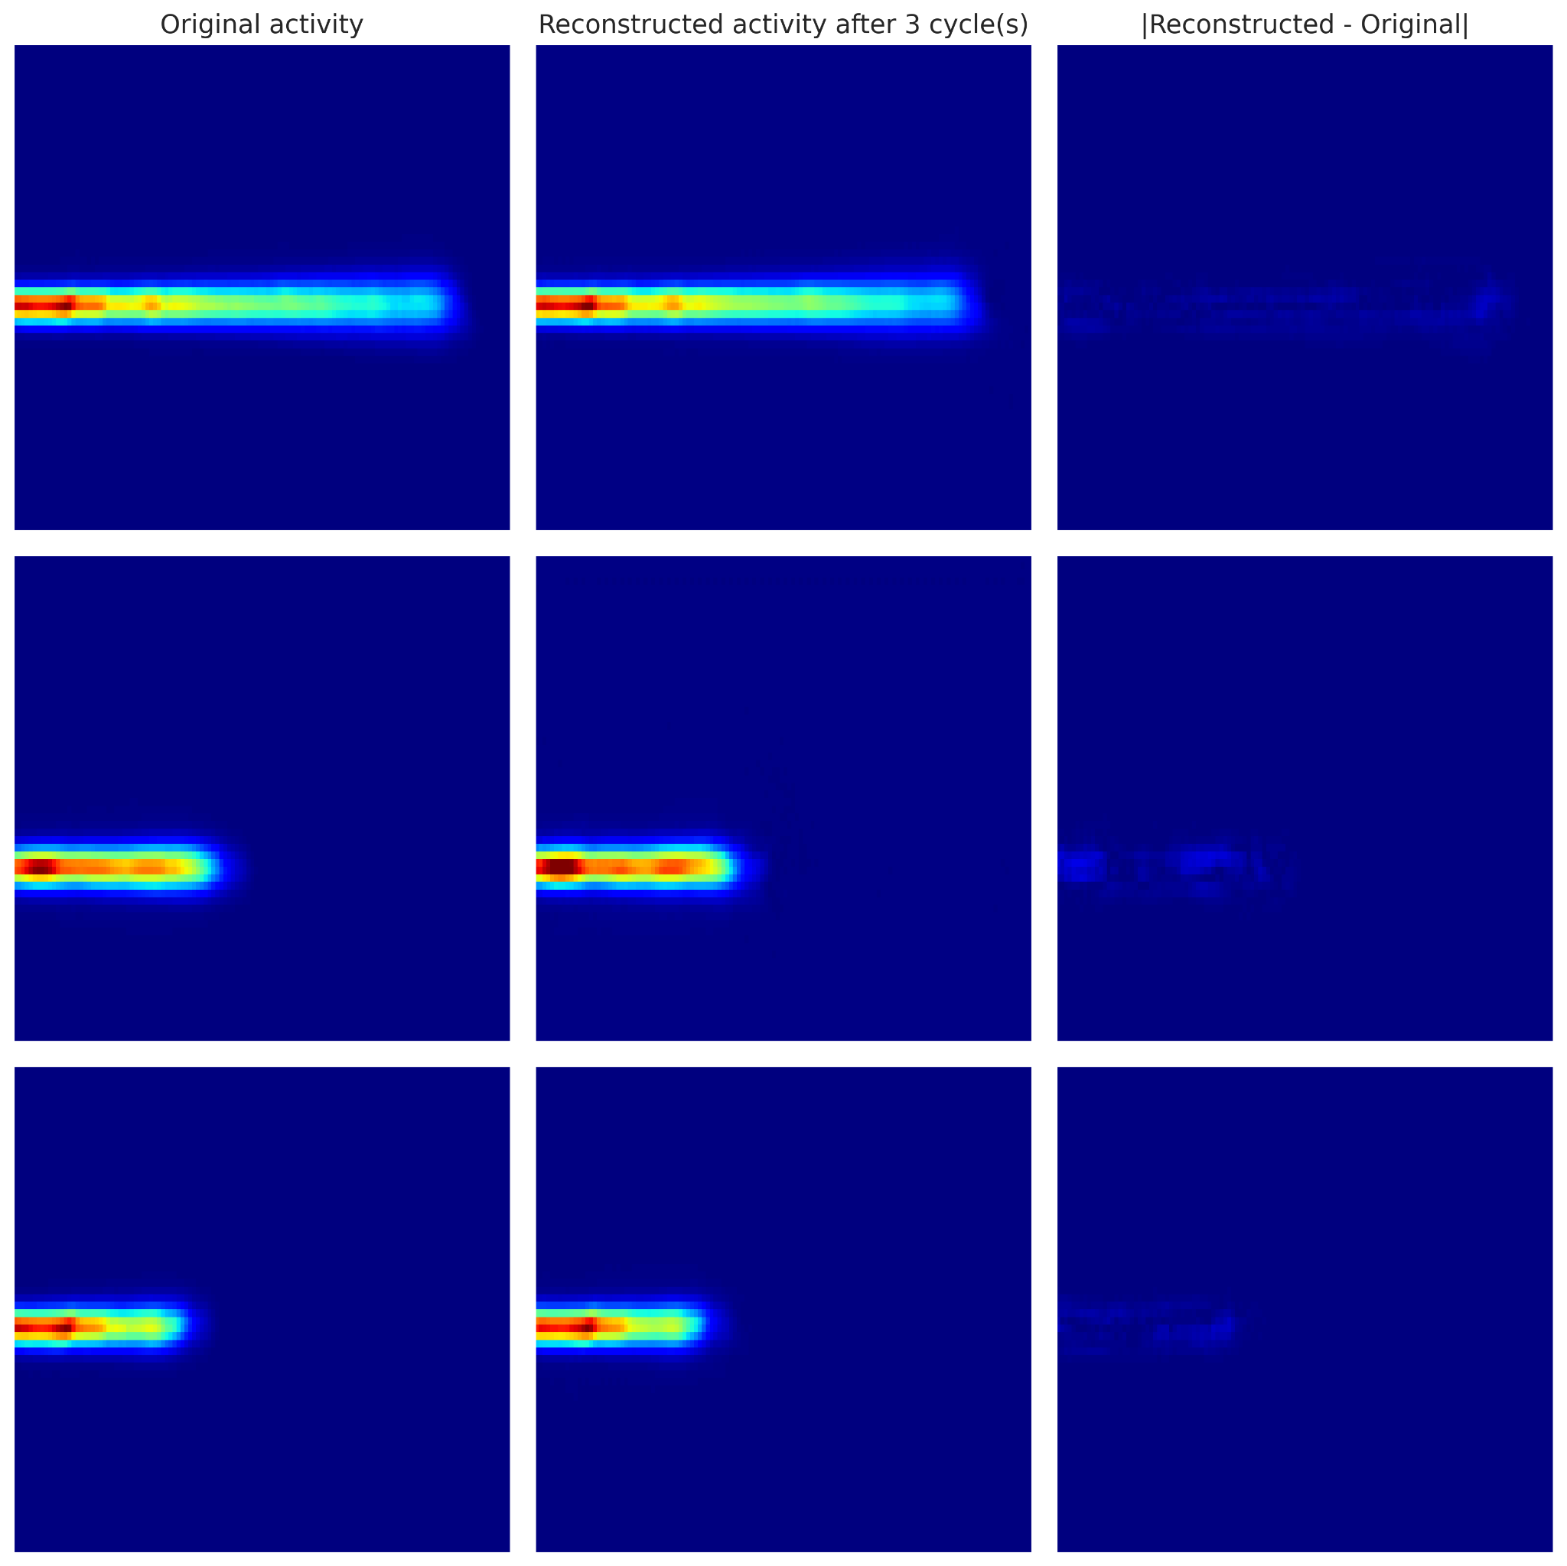

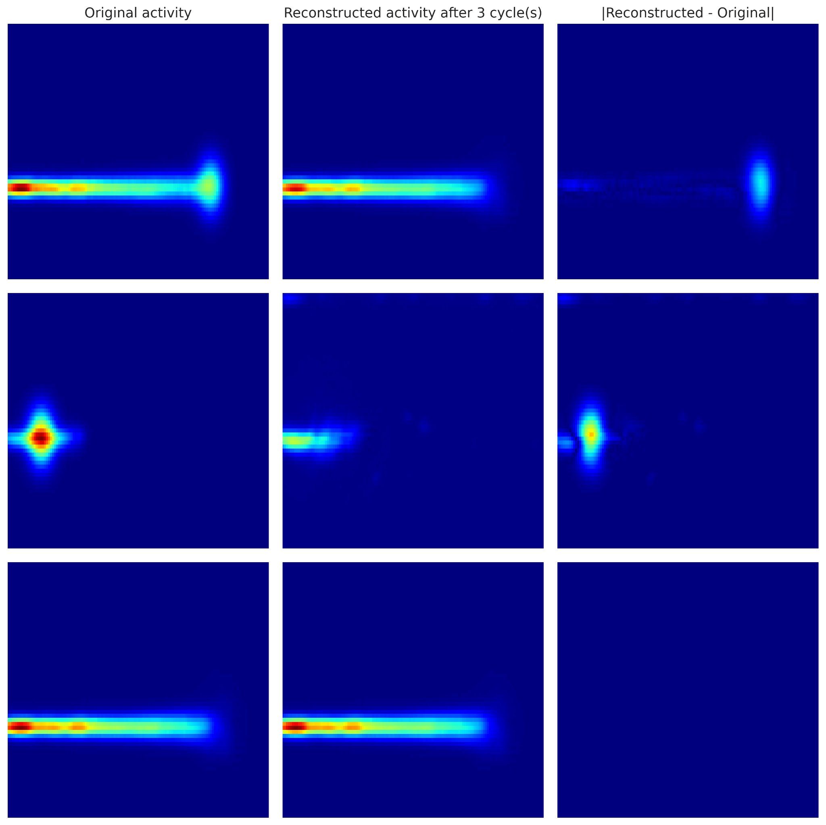

Results: Out-of-distribution Sample Detection
Final Error (3 iterations)
|Estimated - Input|
Activity (Input)
In-Distribution Sample
Out-of-Distribution Sample
(Gaussian Artifact)
Notes:
what could introduce the artifact? the reconstruction, something in the medium?

Slide 12
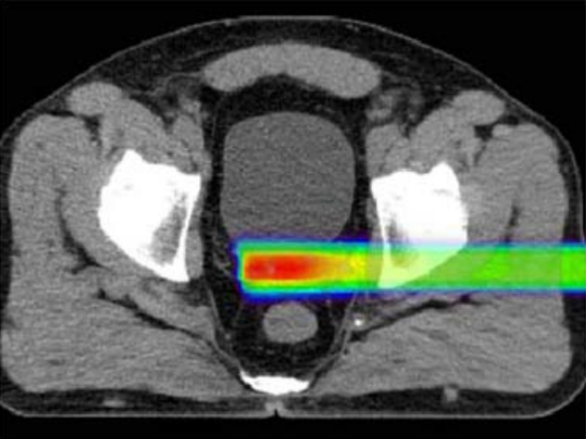
Discussion
Future Work
Robust, scalable models improved by training with gamma index
Fast enough:
4h Simulation + Training < 24h between CT and treatment.
Sub-millimeter precision
Train with PET-reconstructed activity
Include Spread Out Bragg Peaks (sum of many beams)
Explore diffusion-based models
Extend to Prompt-Gammas
^{Spread Out Bragg Peak}
Onecha et al. 2021
Notes:
diffusion based models can produce more detailed images
PG, which are byproducts of the proton beam interacting with tissue

Slide 13





Acknowledgements
Contact email: jlopezhe@ucm.es
AGRADECIMIENTOS:
Prototwin Project (TED2021-130592B-I00) funded by MCIN/AEI/10.13039/501100011033 and by the European Union NextGenerationEU/PRTR.
Fascina Project (PID2021-126998OB-I00) and 3PET Project (PDC2022-133057-I00) funded by MCIN/AEI/10.13039/501100011033 and by the European Union NextGenerationEU/PRTR.
Tartaglia Project (MIA.2021.M02.0005) - Ministerio de Asuntos Económicos y Transformación Digital, financiado con fondos del Plan de Recuperación, Resiliencia y Transformación de la Unión Europea a través de los fondos Next Generation EU. TARTAGLIA está enmarcado dentro del programa Misiones de I+D en Inteligencia Artificial de la agenda España Digital 2025 y de la Estrategia Nacional de Inteligencia Artificial.
Pablo Cabrales was also funded by Complutense University Predoctoral Fellowship

Slide 14
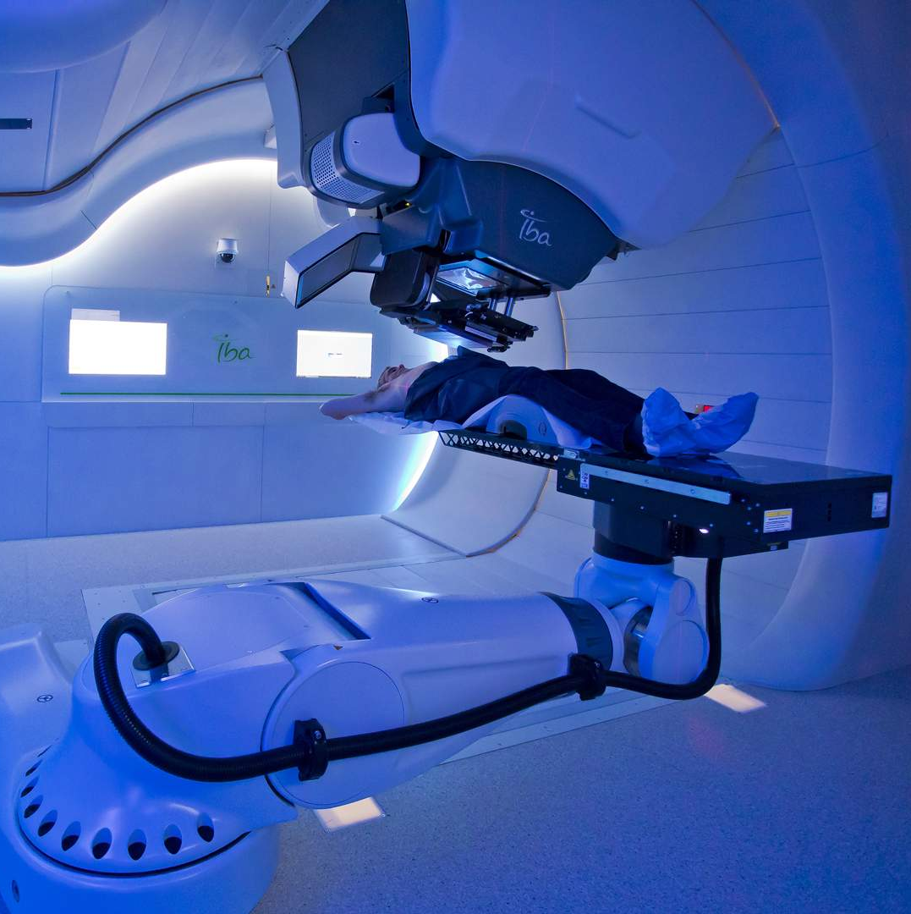
Thank you for your attention!
A State-of-the-Art Deep Learning Approach to Proton Dose Reconstruction from PET Activity Measurements
Pablo Cabrales Miró-Granada (pcabrale@ucm.es)
Grupo de Física Nuclear @ UCM
Quironsalud proton therapy facility, Madrid

